Slide 1
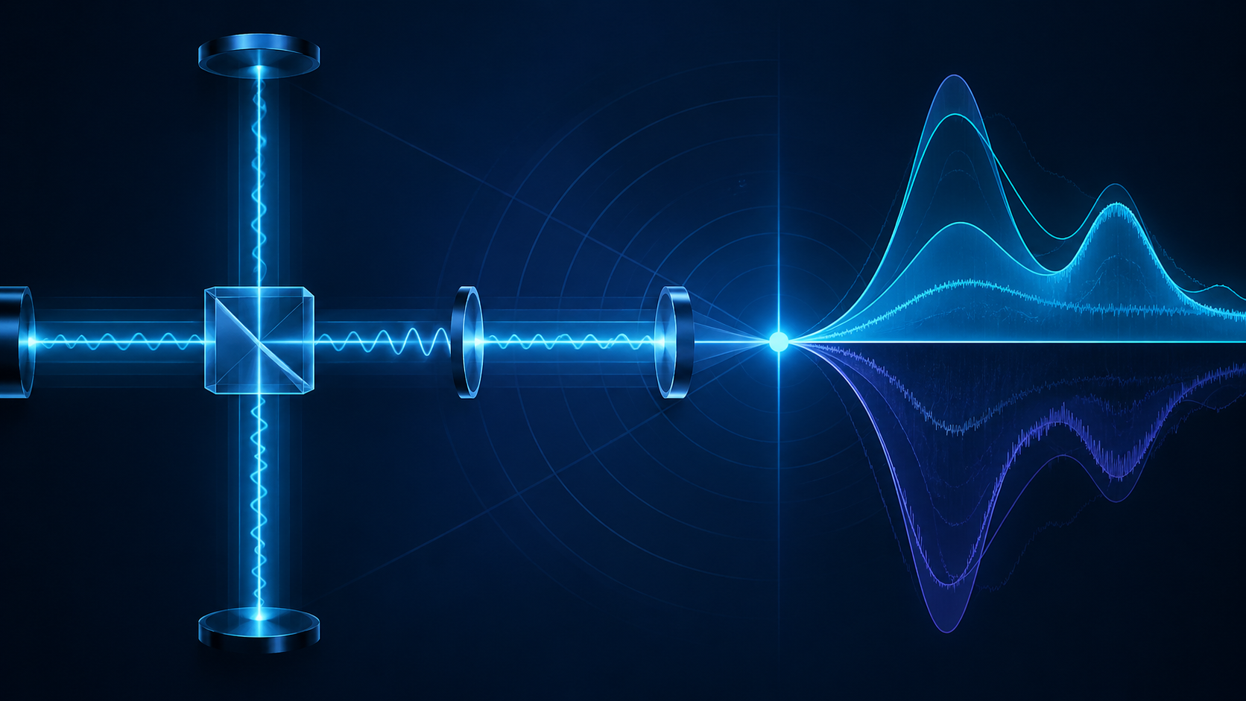
PQSENSING · MINIMUM VIABLE VALIDATION SPRINT
Noise-Stationary
Interferometer Locking
A tabletop Mach-Zehnder experiment to test whether locking to a normalized noise slope-null can reduce jitter-induced measurement noise versus conventional power locking.
Immediate ask: $10K prototype/data sprint
Vnorm
δ
MZI
Nband / P^k objective
slope-null operating point
first validation platform
PQSensing · Confidential discussion draft · 2026
pqsensing.com
Notes:
Opening: This is not a request for a full quantum hardware build. The first milestone is a lean classical tabletop Mach-Zehnder data sprint to test the control thesis behind Noise-Stationary Locking. If the data is positive, it becomes leverage for licensing, SBIR/STTR, strategic partners, and larger capital.

Slide 2

PROBLEM
Power locks protect the fringe — not necessarily the measurement noise.
Fieldable interferometric sensors face nonstationary disturbances: vibration, thermal drift, laser frequency noise, pointing jitter, speckle, platform motion, and mutual interference.
Conventional locks stabilize optical power or a power-derived error signal.
The power extremum can differ from the noise-optimal operating point.
Detuning jitter can be converted into excess readout noise in the protected measurement band.
The gap: a robust control layer that optimizes measurement noise directly.
Source context: DARPA RoQS notes quantum sensors degrade in real-world settings due to vibrations, electromagnetic interference, and environmental disturbances.
PQSensing · Confidential discussion draft · 2026
pqsensing.com
Notes:
Problem narrative: Do not oversell this as replacing all stabilization. The key point is that a power lock can be stable and still not minimize the measurement-band noise. NSL targets the objective that matters to sensing performance.

Slide 3
SOLUTION
Lock at the Vnorm slope-null.
NSL turns the detector stream into a control objective tied to measurement noise, then servos the operating point to a slope-null condition.
Core equation
Vnorm
= Nband / P^k
1 Measure
2 Compute
3 Dither
4 Servo
Detector signal y(t)
Nband, P, Vnorm
δ at fd outside band
dVnorm/dδ → 0
k ∈ [0,2]
+ power-floor penalty
+ mislock recovery
The technical wedge is not “dither locking.” It is demodulating a normalized band-limited noise objective and driving its operating-point slope toward zero.
Source context: PQSensing patent draft and fallback claims define Nband, P, Vnorm=Nband/P^k, dither/demod, power floor, and reacquisition logic.
PQSensing · Confidential discussion draft · 2026
pqsensing.com
Notes:
Solution narrative: Walk through the four blocks. The detector signal becomes a band-limited noise metric. That metric is normalized by optical power. A small dither probes the slope of that objective with respect to the operating point. The feedback loop drives the estimated slope toward zero while protecting against trivial low-power solutions.

Slide 4
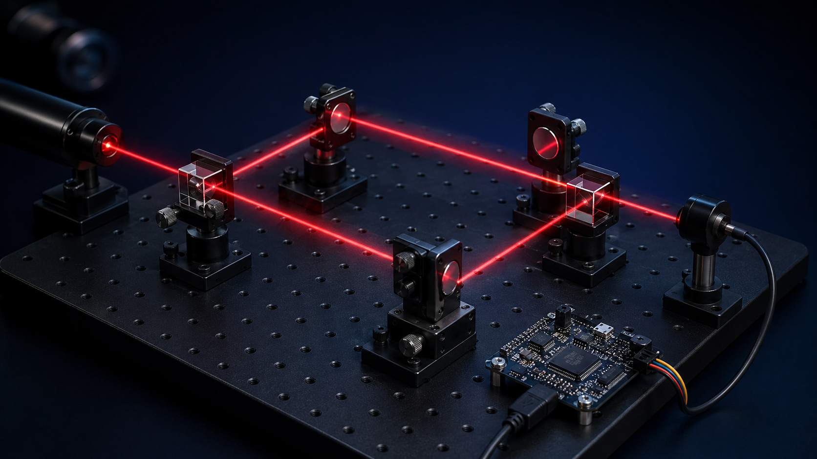
VALIDATION PLAN
Tabletop MZI proves or kills the thesis.
The first experiment is classical and intentionally small: produce defensible traces that compare power locking against NSL under controlled detuning jitter.
Sweep δ
Map P(δ), Nband(δ), Vnorm(δ).
Inject jitter
Apply repeatable detuning disturbance.
Engage NSL
Dither/demod Vnorm; servo slope-null.
Compare
Power lock vs NSL data package.
Success targets: ≥6 dB first-demo reduction; stretch 10–20 dB; ≥5 successful reacquisitions.
PQSensing · Confidential discussion draft · 2026
pqsensing.com
Notes:
Validation narrative: The strongest pitch is falsifiability. We are not saying the quantum product is already built. We are saying a lean tabletop MZI can produce the critical curve: where power lock sits, where the normalized noise objective is stationary, and what happens under injected jitter.

Slide 5
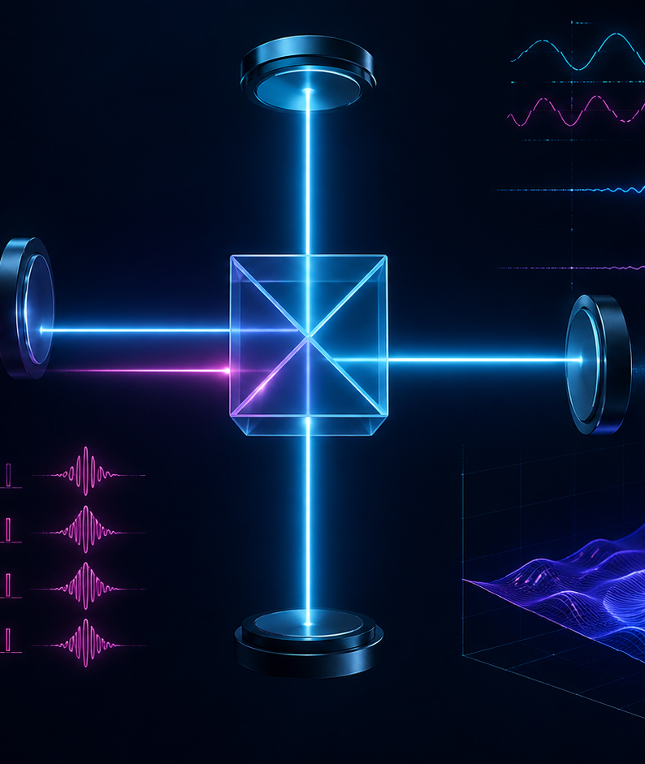
IP
A filed architecture with fallback claim depth.
The IP narrative is anchored to a specific control stack rather than a generic “better interferometer.”
01
NSL control
PSD/Welch or bandpass-square Nband, P metric, Vnorm=Nband/P^k.
02
Control specificity
Dither outside protected band, demodulate Vnorm, drive δ to slope-null.
03
Robust operation
Power-floor penalty and mislock-to-reacquisition state logic.
04
Expansion layer
Dark-port g(t) coding, homodyne recovery, squeezed-state variants, PIC/SU(1,1).
Licensing wedge: a control method / firmware layer for interferometric sensor OEMs.
Source context: PQSensing nonprovisional draft and fallback claim package. Not legal advice.
PQSensing · Confidential discussion draft · 2026
pqsensing.com
Notes:
IP narrative: Stay crisp. The invention is more defensible when described as normalized noise-objective control with guardrails and reacquisition, plus dark-port injection as a second layer. Avoid broad unsupported claims in verbal pitches.

Slide 6
MARKET
Robust sensing is the transition bottleneck.
The first market is not a finished quantum sensor. It is a robust control layer that can improve interferometric readout in systems where field disturbances erase lab-grade sensitivity.
$7–10B
$1.3–1.5B
quantum sensing by 2035
(McKinsey scenario)
quantum sensor market by 2034
(market-research estimates)
Defense PNT / ISR
GPS-denied sensing, inertial/gravimetry, platform vibration.
Metrology OEMs
Cavities, MZI, Michelson, mode cleaners, precision phase sensing.
LiDAR / FSOC
Dark-port coding, interference rejection, correlation signatures.
Sources: DARPA RoQS; McKinsey Quantum Technology Monitor 2025; Precedence Research and Fortune Business Insights quantum sensor market pages.
PQSensing · Confidential discussion draft · 2026
pqsensing.com
Notes:
Market narrative: The market estimates are directional and vary by source. The pitch should emphasize a wedge: control software/firmware and validation data for robust interferometric readout, not building every sensor class from scratch.

Slide 7
TEAM
Lean validation. Partner-ready.
PQSensing
MZI data sprint
1
Classical tabletop proof
Validation-first operating model using accessible hardware, open-source DSP, reproducible analysis, and partner-ready data before larger capital.
SBIR / partner demo
2
All-fiber + dark-port code
Practical hardware discipline: prove the core effect before scaling.
Open-source DSP / reproducible data package for credibility.
Quantum integration
3
Squeezed-state / homodyne path
University lab path for OPO/squeezed-light integration after classical validation.
SBIR/STTR and licensing path for non-dilutive or strategic capital.
Licensing
4
OEM / defense / photonics
Source context: PQSensing technical roadmap.
PQSensing · Confidential discussion draft · 2026
pqsensing.com
Notes:
Team narrative: The solo-inventor story can be a strength when paired with a lean, measurable experiment. The ask is not to fund a large company immediately; it is to create the minimum data package that makes partner conversations rational.

Slide 8
USE OF FUNDS + ROADMAP
First data package: $10K.
Minimum useful prototype budget: build the tabletop MZI, implement NSL, inject jitter, and package the data for investors, companies, and non-dilutive funding.
Budget allocation
Milestones
Optics + mechanics
$3.0K
0–2 wks
assemble MZI + baseline fringe
Laser/readout/DAQ path
$2.5K
2–4 wks
sweep δ; choose Vnorm band/k
Actuator + driver + control
$2.0K
4–6 wks
closed-loop NSL + jitter tests
DSP, safety, misc.
$1.5K
6–8 wks
raw data, plots, outreach package
Shipping/contingency
$1.0K
Outcome: first credible NSL data package for licensing/SBIR/investor conversations.
Contact: contact@pqsensing.com · pqsensing.com
PQSensing · Confidential discussion draft · 2026
pqsensing.com
Notes:
Use-of-funds narrative: Keep this grounded and specific. The money buys data, not a vague dream. The expected deliverables are a working bench, raw traces, plots comparing lock modes, and a partner/investor-ready package.

